Slide 1
CIS CONTROL 16: ACCOUNT MONITORING & CONTROL-III
ACCOUNT MONITORING & CONTROL

Slide 2
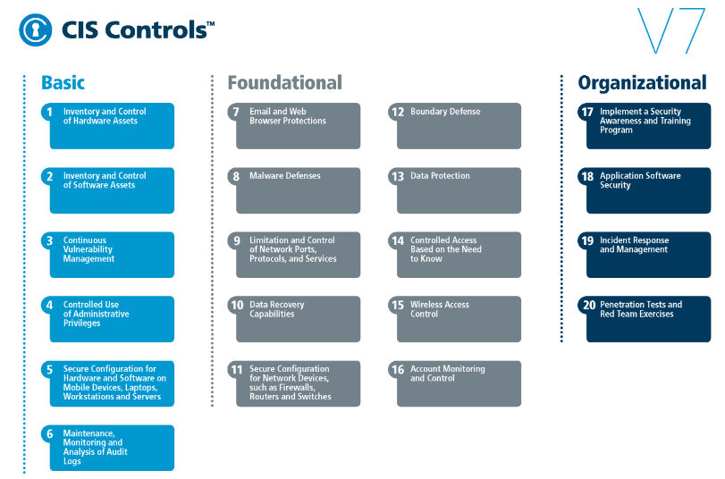
CIS CONTROL 16: ACCOUNT MONITORING & CONTROL-III
https://www.cisecurity.org/controls/

Slide 3
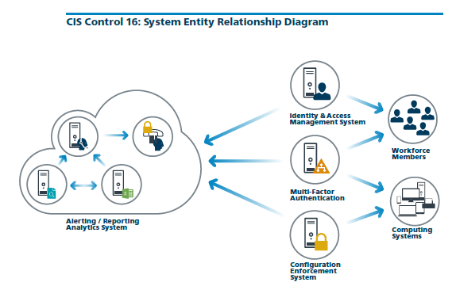
CIS CONTROL 16: ACCOUNT MONITORING & CONTROL-III
https://www.cisecurity.org/controls/

Slide 4
CIS CONTROL 16: ACCOUNT MONITORING & CONTROL-III
16.9: Disable Dormant Accounts
Automatically disable dormant accounts after a set period of inactivity.

Slide 5
CIS CONTROL 16: ACCOUNT MONITORING & CONTROL-III
16.10: Ensure All Accounts Have An Expiration Date
Ensure that all accounts have an expiration date that is monitored and enforced.

Slide 6
CIS CONTROL 16: ACCOUNT MONITORING & CONTROL-III
16.11: Lock Workstation Sessions After Inactivity
Automatically lock workstation sessions after a standard period of inactivity.

Slide 7
CIS CONTROL 16: ACCOUNT MONITORING & CONTROL-III
16.12: Monitor Attempts to Access Deactivated Accounts
Monitor attempts to access deactivated accounts through audit logging.

Slide 8
CIS CONTROL 16: ACCOUNT MONITORING & CONTROL-III
16.13: Alert on Account Login Behavior Deviation
Alert when users deviate from normal login behavior, such as time-of-day, workstation location and duration.
END

